Slide 1


Evading human rights control mechanisms?
A comparative study of state responses to situations of unreturnability in the UK and Germany
Gianna Eckert, PhD Student
Supervisor: Prof. Diego Acosta Arcarazo & Dr. Kathryn Allinson

Slide 2


Slide 3
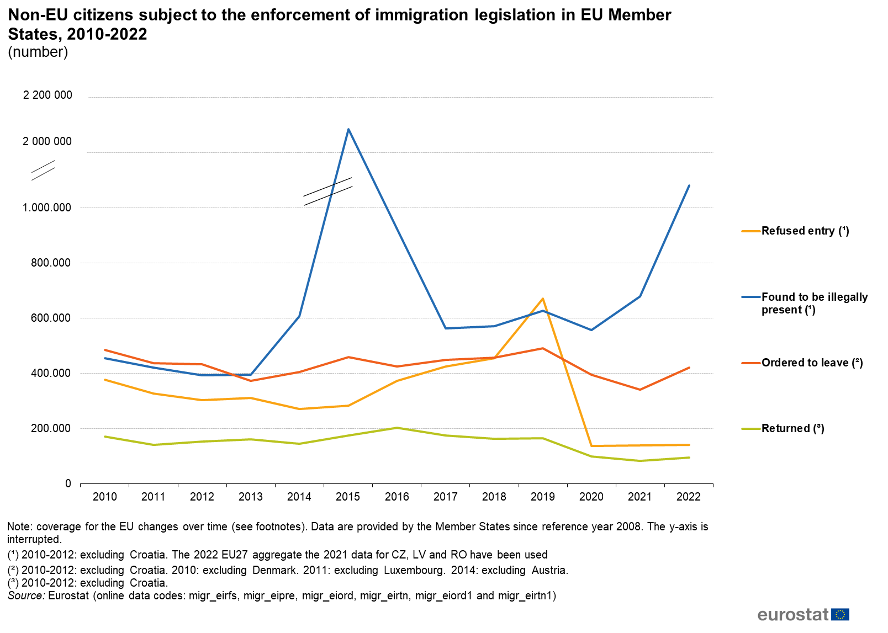
The ‘deportation gap’
Deportations are complex, costly and complicated.
factual and legal barriers to deportation are not uncommon
In 2022, less than a third of all return decisions were enforced in EU member states.
In 2022, Germany planned to carry out 23,337 deportations, but removal was only enforced in 12,945 cases.
Notes:
Statistically, most deportation proceedings fail, as confirmed by recent data from Germany: of 23,337 planned deportations only 12,945 were carried out in 2022.^{[1]} A similar phenomenon can be observed at supranational level, where EU-wide statistics record a considerable discrepancy between the number of people formally ordered to leave and the actual number of returns. According to the EU Commission only 21% of return decisions were enforced in the year 2021.^{[2]} The UK is no exception in this regard, with the numbers of enforced and voluntary returns declining since 2010.^{[3]} At the same time, the number of asylum applications has remained high, with rejected asylum seekers becoming trapped in limbo.^{[4]}
^{[1]} Tagesschau online, ‚Zweidrittel aller Rückführungen gescheitert‘ (5.3.2023) accessed via
https://www.tagesschau.de/inland/innenpolitik/abschiebungen-migration-einwanderung-101.html
^{[2]} European Commission, ‘Towards an operational strategy for more effective returns’, COM(23)45 Final accessed via https://home-affairs.ec.europa.eu/system/files/2023-01/Towards%20an%20operational%20strategy%20for%20more%20effective%20returns_en.pdf
^{[3]} Rajeev Sayl, ‘Nine in ten people refused asylum in 2020 free remain in UK, The Guardian (22.07.2022) accessed via https://www.theguardian.com/uk-news/2022/jun/22/nine-in-10-people-refused-asylum-in-2020-free-to-remain-in-uk-home-office
^{[4]} The Migration Observatory, Briefing (19.08.2022) accessed via
https://migrationobservatory.ox.ac.uk/resources/briefings/migration-to-the-uk-asylum/

Slide 4
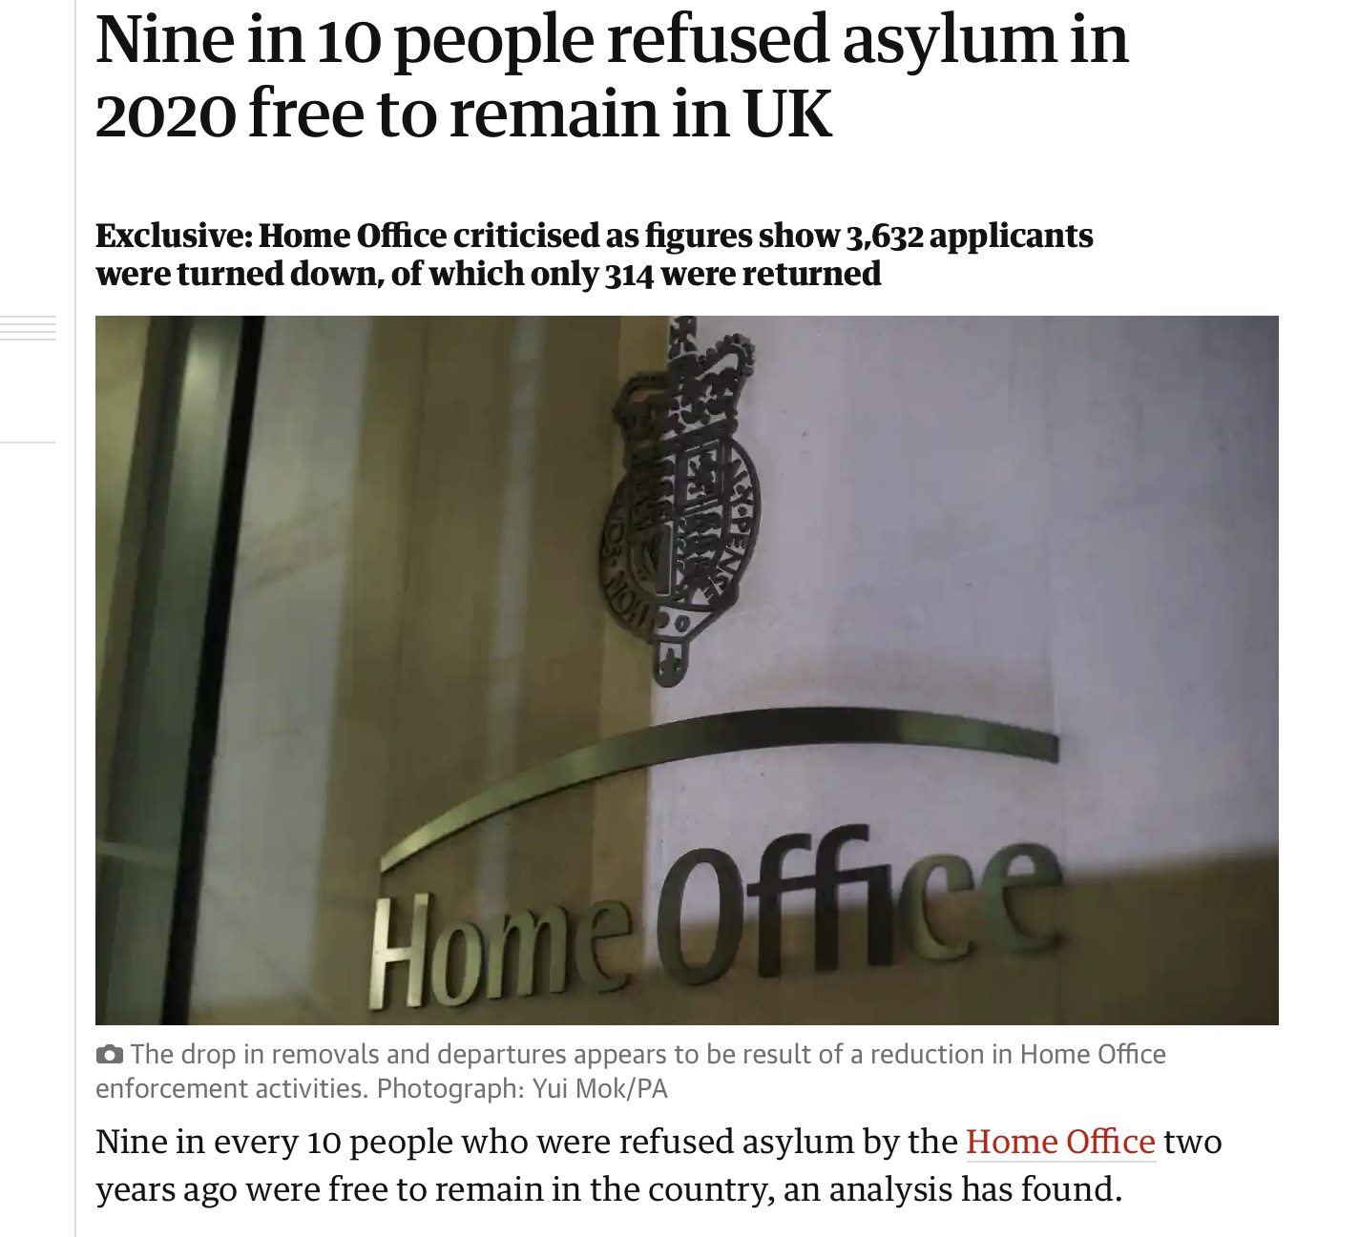
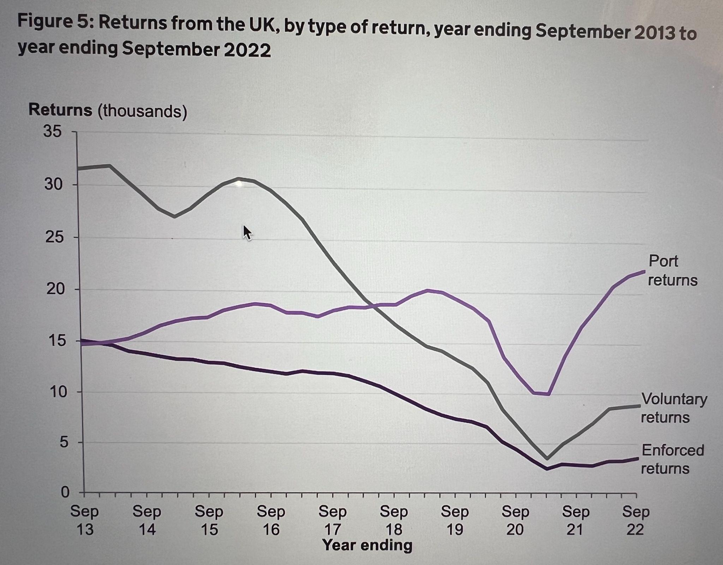
Since 2013, the number of removals has fallen in the UK.

Slide 5

The issue of ‘unreturnability’
Notes:
topic of high relevance politically at member state level and at eu level, where many ideas are discussed on how to increase the number of returns- a concern which is also at the heart of the new migration pact
academically also not a novel issue, large scale comparative studies that date back until the beginning of the 2000s and then around 2010 the big REGINE study completed by ICMPD and the topic also featured in some FRA reports
then after 2017 we saw the Undesirable but unreturnable report that specifically looked into unreturnable migrant offenders
however these are large scale comparative studies and their multi country has in some way come at the expense of the depth of the examination
they provide very much a macro level overview
in recent years we have seen a small number of studies that looked more at the member state level, so for instance in may the book deportation limbo was published which looked into swedens approach to unreturnable refused asylum seekers
and also this year kevin fredy hinterbergers book got published on regularisations in spain austria and germany and he also coonsiders member states approach to unreturnability through the lens of regularisation

Slide 6
Investigating life in the ‘deportation gap’
Which laws, regulations and policies apply to migrants whose removal is impeded?
How do migrants experience these regulations and what is their impact on migrants and their ability to exercise their rights?
Germany
United Kingdom
statutory toleration also known as ‘qualified unlawful stay’ (Hinterberger 2023)
‘unreturnability’ recognised in legal terms (at least temporary unreturnability)
numerous restrictions imposed on tolerated migrants aimed at containment
new regularisation mechanism launched in 2023 for long-term tolerated migrants
many unreturnable migrants in detention, most released on immigration bail (bail conditions vary and may include reporting obligations and GPS tracking)
most rejected asylum seekers on section 4 support
no access to the labour market or regularisation
acute risk of exploitation and destitution
Notes:
and I very much align with this member state, micro level approach and will however go beyond the lens to regularisation and just examine all laws policies and regulations that apply to unreturnable migrants in the uk and germany
on the german side situations of unreturnability are managed through the the mechanism of statutory toleration also known as duldung
the duldung does not amout to an official residence permit
tolerated migrants continue to reside irregularly in germany, but criminal sanctions for irregular residency are waived
They are known to the authorities and

Slide 7
Objectives
investigate the situation of irremovable migrants in the UK and Germany from a socio-legal perspective, focusing on migrants’ experiences of the existing regulations, their practical effects, (dys)functions and gaps.
Provide a comprehensive and nuanced overview of the laws, regulations and administrative practices applicable to unreturnable migrants
Examine the ways in which these regulations impact on migrants and their rights
Conceptualise the tension between ensuring minimum standards and migration control objectives inherent to these practices and assess whether they attempt to indirectly induce deportation
Examine legal limits under international human rights law regarding the use of indirect deportation measures

Slide 8
Why Germany and the UK?
feature among the top four deporting countries in Europe (Germany, the UK, France and Sweden) >> unreturnability closely linked to enforcement policies and budgets
Increasing number of references made by UK government to German asylum and immigration system and practices
Pairing these countries offers a novel perspective and ‘vocabulary’ to analyse the situation: unreturnability recognised in legal terms in Germany; the ‘hostile environment policy’: only a British phenomenon?
both countries currently undergoing historical shifts in their immigration and asylum laws

Slide 9
Methodology: A mixed methods approach
Comparative method
2. Socio-legal comparison
terms of comparison emerge from qualitative data
New legal realism: Investigating ‘law in action’ rather than ‘law in the books’ & combining bottom-up research methods with top down perspectives
New critical legal realism: influenced by critical scholarship situating law in the context of power
functionalist approach deemed unsuitable for the purposes of analysing the phenomenon of unreturnability
identifying differences/similarities between the two country approaches
3. Empirical data collection
4. Doctrinal analysis
conducting 25-30 interviews in both countries with NGO support workers, solicitors and unreturnable migrants
transcribe and code interviews identifying similarities/differences
analyse jurisprudence and national legal frameworks
Deploy doctrinal methods to analyse lawfulness of indirect deportation measures under international law (following a critical legal approach)
Notes:
terms of comparison emerge from qualitative data
socio-legal approaches view law in its societal context and study how law is made, interpreted, applied, enforced and experienced (‘law’ is broadly defined)
new legal realism: focuses on studying ‘law in action within and among communities’ (Talesh et al 2021); combining bottom-up research methods with top-down perspectives

Slide 10
Added value and possible contributions
nuance our understanding of responses to unreturnability and their implementation by adopting a ‘law in action’ approach, zooming in on the dysfunctions and contradictions of resulting from current regulations
conceptualising novel initiatives undertaken by member states to ‘prevent’ situations of unreturnability and conceptualise tension between exclusion and inclusion objectives
studying the operation of indirect removal measures and assess their lawfulness under human rights law
situate current state practices within the context of (temporal) fairness and explore alternative ways of constructing legal protection for irremovable migrants

Slide 11

Outline
Introduction: Europe’s deportation regime and cases of failed deportation
‘Life in the deportation gap’: Causes and implications
The phenomenon of unreturnability in the literature
Studying ‘non-deportation deportation laws’ in the UK and Germany
Methodology: A mixed methods approach
Self-deportation laws in Germany (Empirical chapter on Germany)
Self-deportation laws in the UK (Empirical chapter on UK)
The lawfulness of indirect deportation measures under international human rights law law
Conclusion

